Slide 1
Read me first
Slides 2 and 3
These are example announcement posters that communicate the arrival of Ideagen Hub. Please update with your system information.
Slides 4 and 5
These slides explain the key functionality of Ideagen Hub. Please update then with your information before printing them or placing them on your intranet.

Slide 2


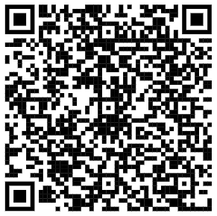
Hub is coming…
Ideagen Hub is our new way to access Ideagen [SOLUTION NAME].
It will be live across the organisation in [DATE]!
For more information, please visit [Intranet Name] or contact [insert your Ideagen solution team group email here]
luminate.Ideagen.com

Slide 3
Hub is here!
Ideagen Hub is our new way to access Ideagen [SOLUTION NAME].
For more information, please visit [Intranet Name] or contact [insert your Ideagen solution team group email here]
luminate.Ideagen.com

Slide 4
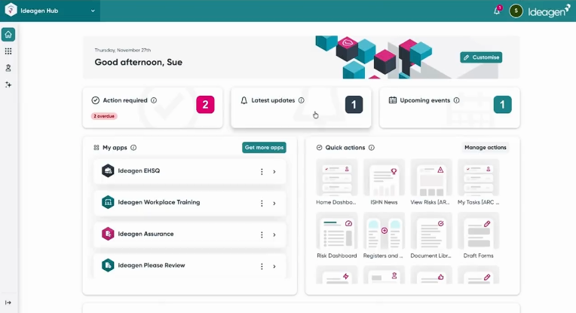
Introducing
Hub
Manage your profile
Manage users across all Ideagen solutions
All of your actions in one place
Start your most used workflows
Launch your Ideagen solution
Launch Mazlan – our regulatory and EHS AI
luminate.Ideagen.com

Slide 5
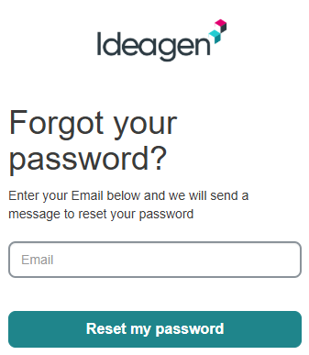
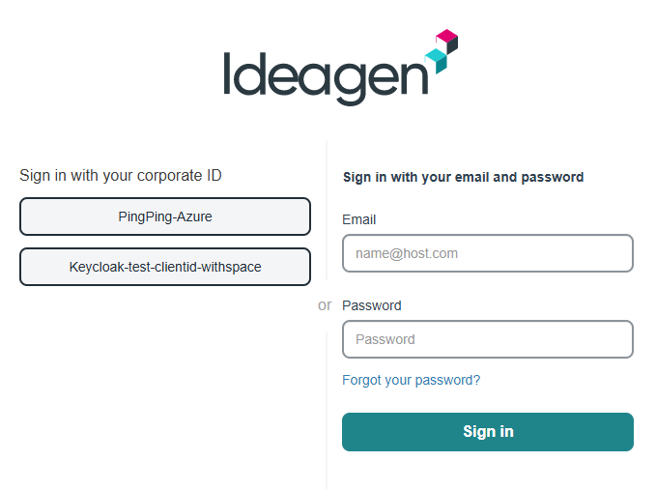
Hub log in made easy
Step 1: Click on the link in your welcome email
2
3
Step 2: Reset your password
Step 3: Log in with your email and new password
For more information, please visit [Intranet Name] or contact [insert your Ideagen solution team group email here]
luminate.Ideagen.com

